Slide 1
Drainage Products by REIVILO Ltd.
2012

Slide 2
Topics overview
Linear Drainage
Point Drainage
Access Covers
Pull Boxes
Other
Contact Details

Slide 3
Linear Drainage

Slide 4
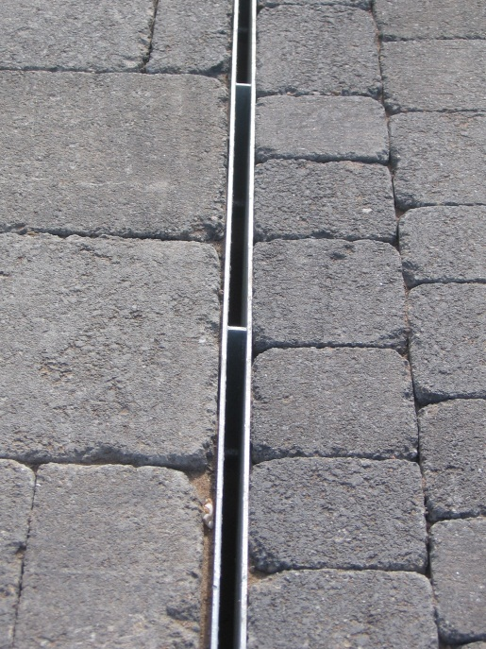
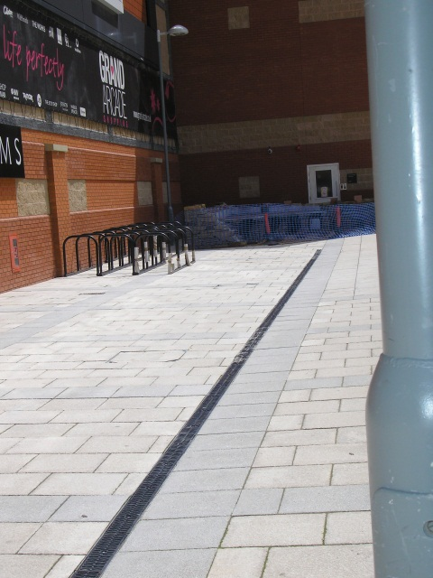
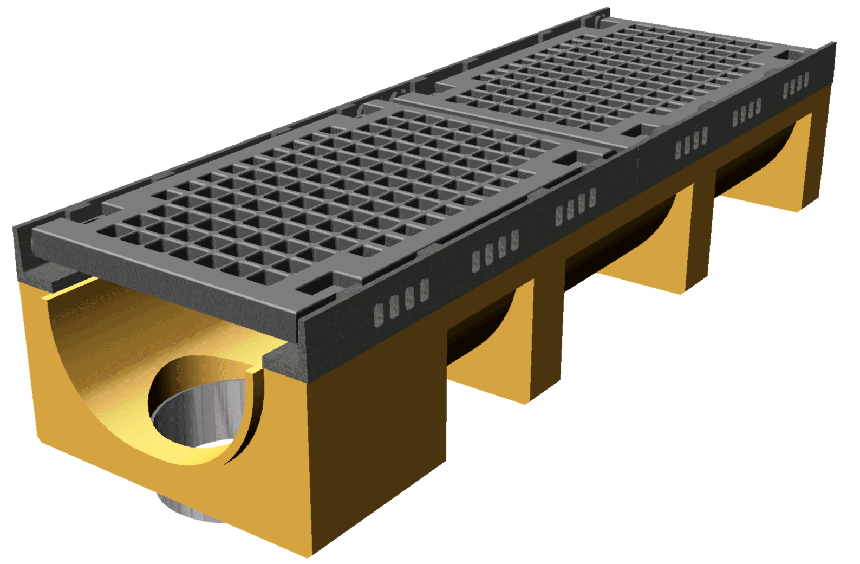
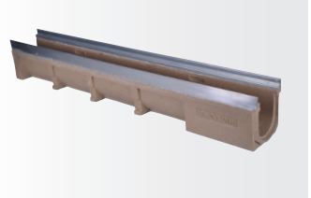
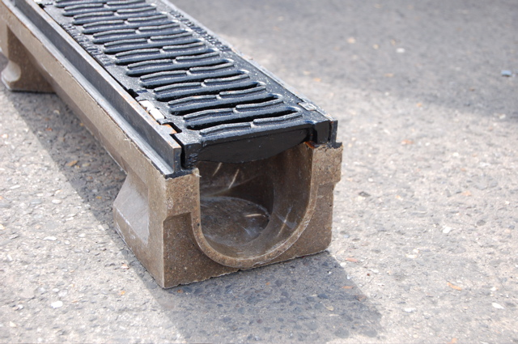
Polymer Concrete Water Drainage
For more than 10 years, Reivilo Ltd has been producing Polymer Concrete channels.
The range proposed has been developed to match EN1433 requirements.
The range is made of channel for domestic applications up to Industrial & Civils and Road.

Slide 5
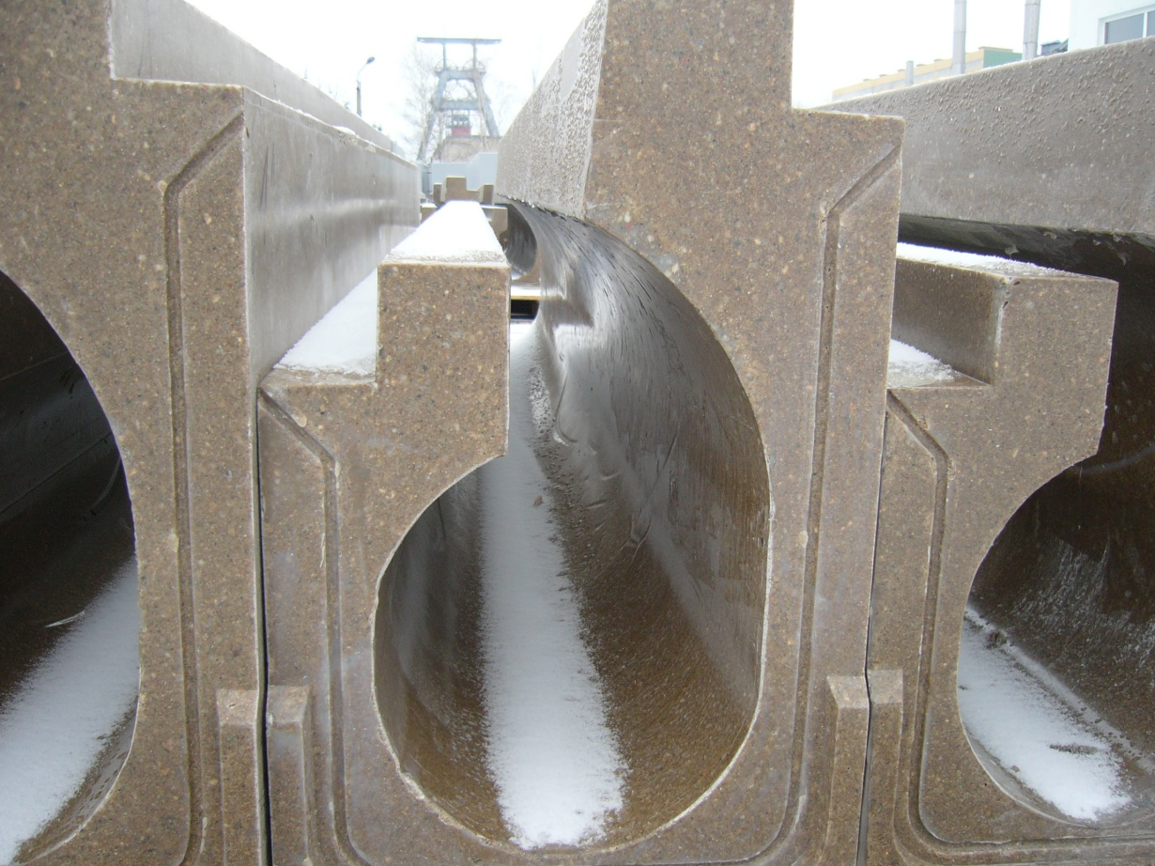
Tunnel Drainage Products
Tunnel channels are used in those locations in order to drain as fast as possible the surface water. They form a perfect kerb.

Slide 6
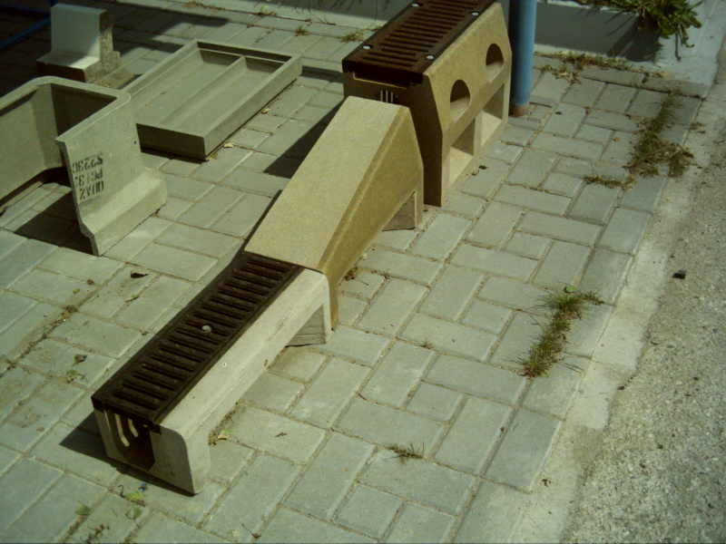
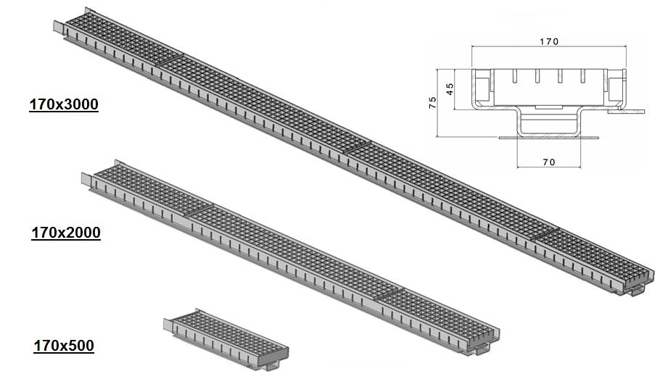
Bridge Elements
Bridge element group of products are composed of several drainage systems made of polymer concrete, Stainless Steel or Ductile Iron.

Slide 7
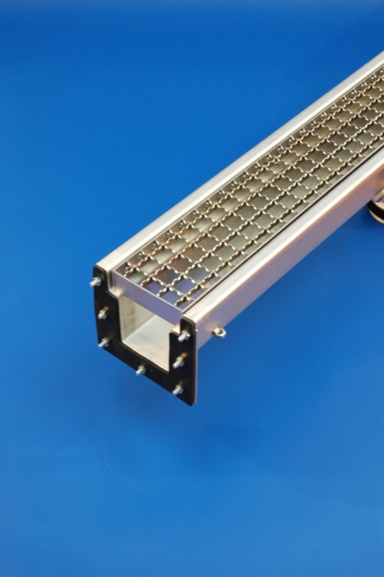
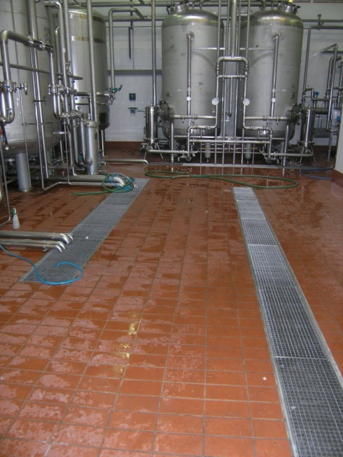
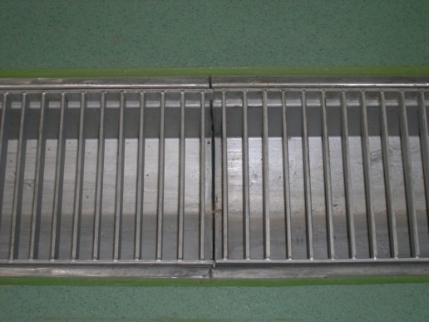
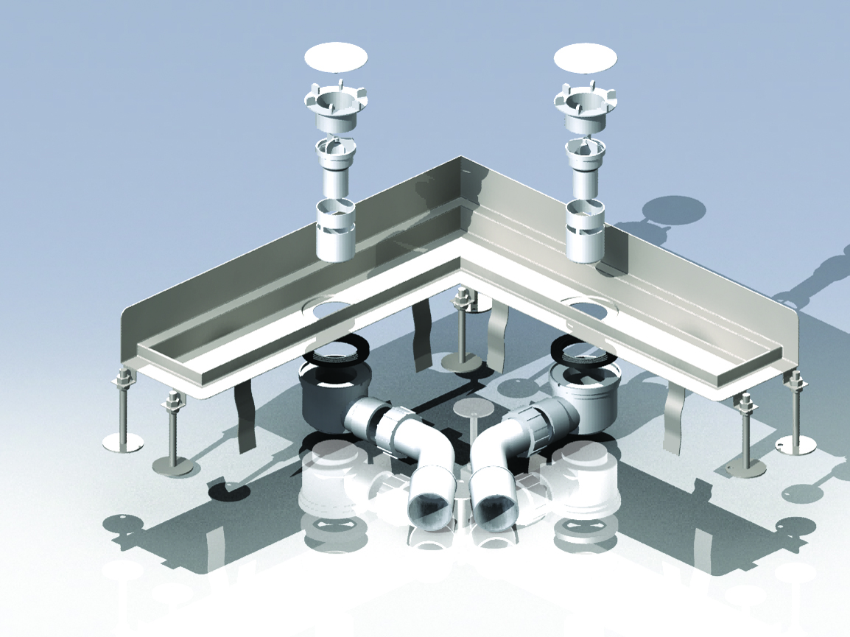
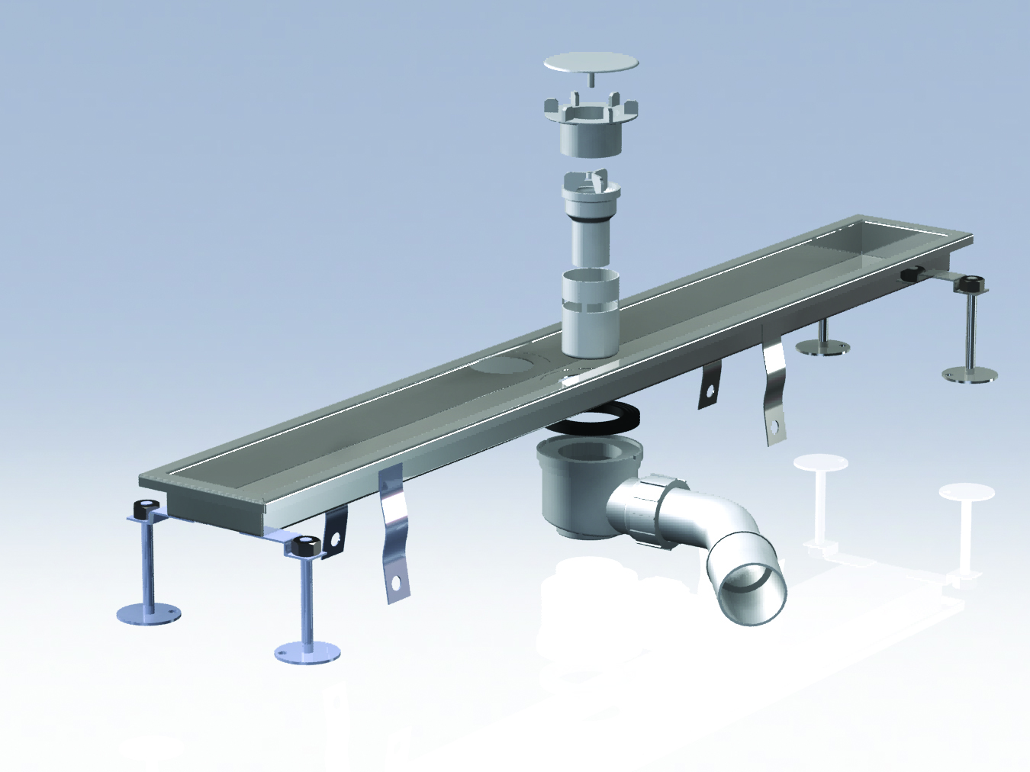
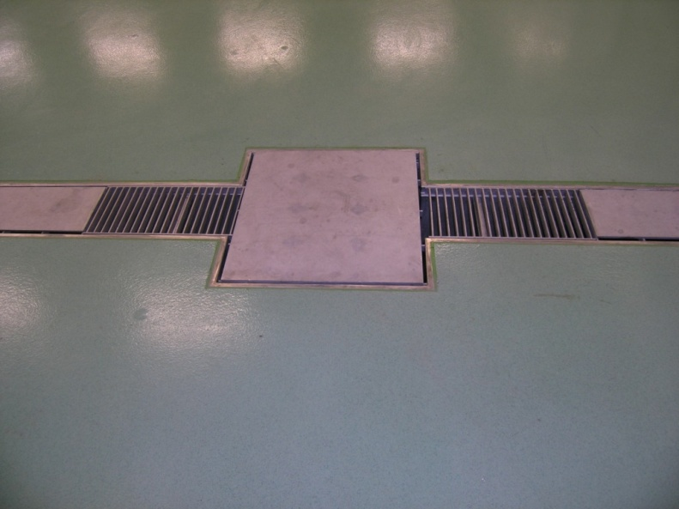
Stainless Steel Channels
In the case of very sensible applications, S/S products are requested.
In kitchens, bathrooms, chemical or petrochemical sites, stainless steel channels and accessories will be used.
Our range covers all major S/S types: AISI 304 – 316 and 316L.

Slide 8
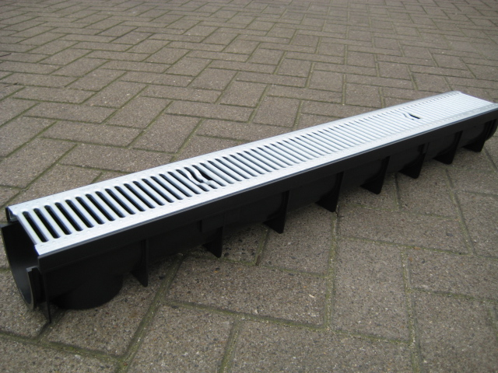
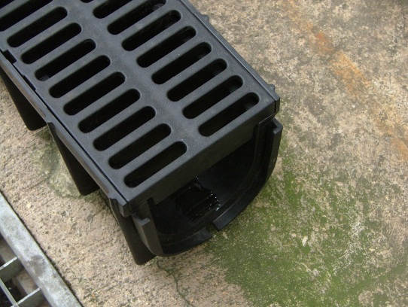
Thermoplastic Channels & Gratings
Thermoplastic channels are available in different sections and loading classes.
Depending on various applications, the material used to manufacture those parts will vary.
Thermoplastic products are light but robust. They are also eco-friendly as they are manufactured from recycled material.

Slide 9
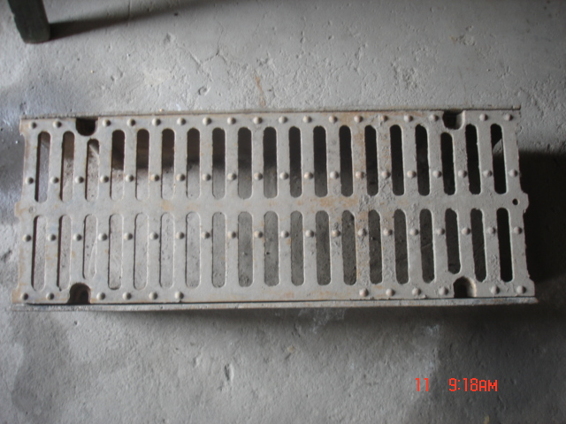
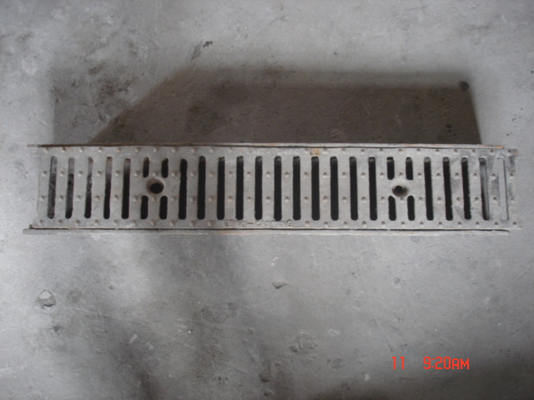
Cast Iron Channels
Cast Iron Channels & Gratings.
Various sections: 100 & 150 and 200
Various lengths: up to 750mm.

Slide 10
Point Drainage

Slide 11
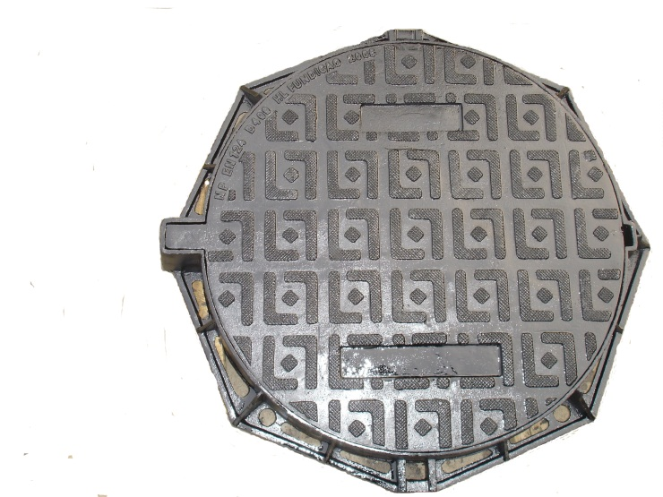
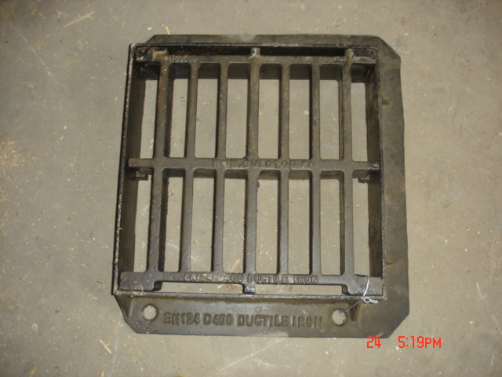
Manhole Covers & Gully Gratings
In opposition to the linear drainage, some projects will need alternative solution. One of them is the use of Point Drainage.
Working with several foundries both in China and India, sourcing those products is a regular job for us.

Slide 12
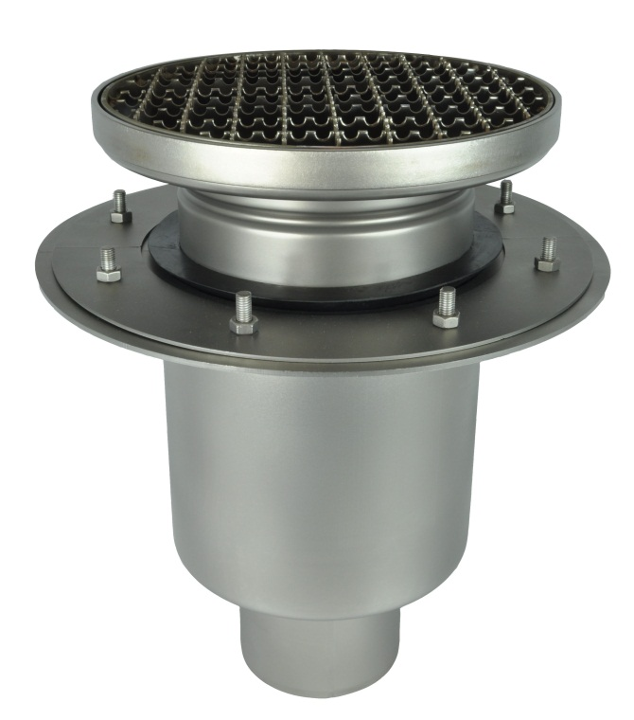
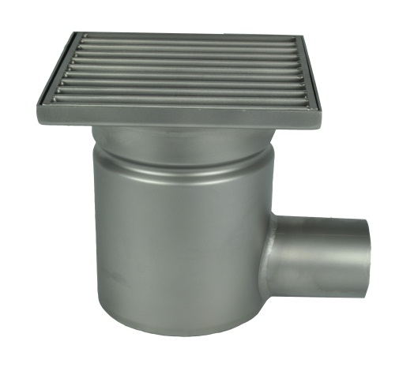
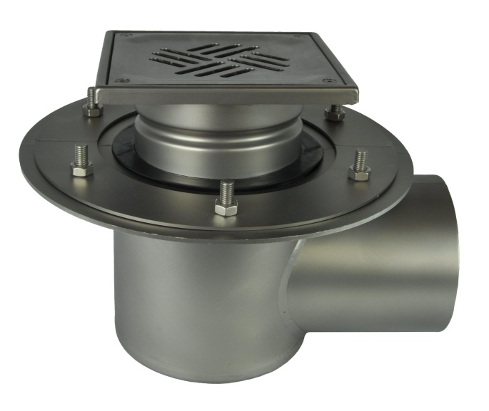
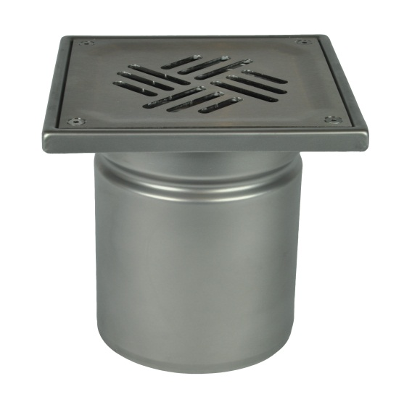
Floor Drain
All floor drains and rodding eyes are made from stainless steel V2A (AISI 304) or V4A (AISI 316).
The floor drain type depends on the load, amount of drained water and structural parameters (i.e. the floor thickness).
The floor drains are made of 1,5-2 [mm] steel sheets.
All components are welded in argon shield to ensure high quality of joints

Slide 13
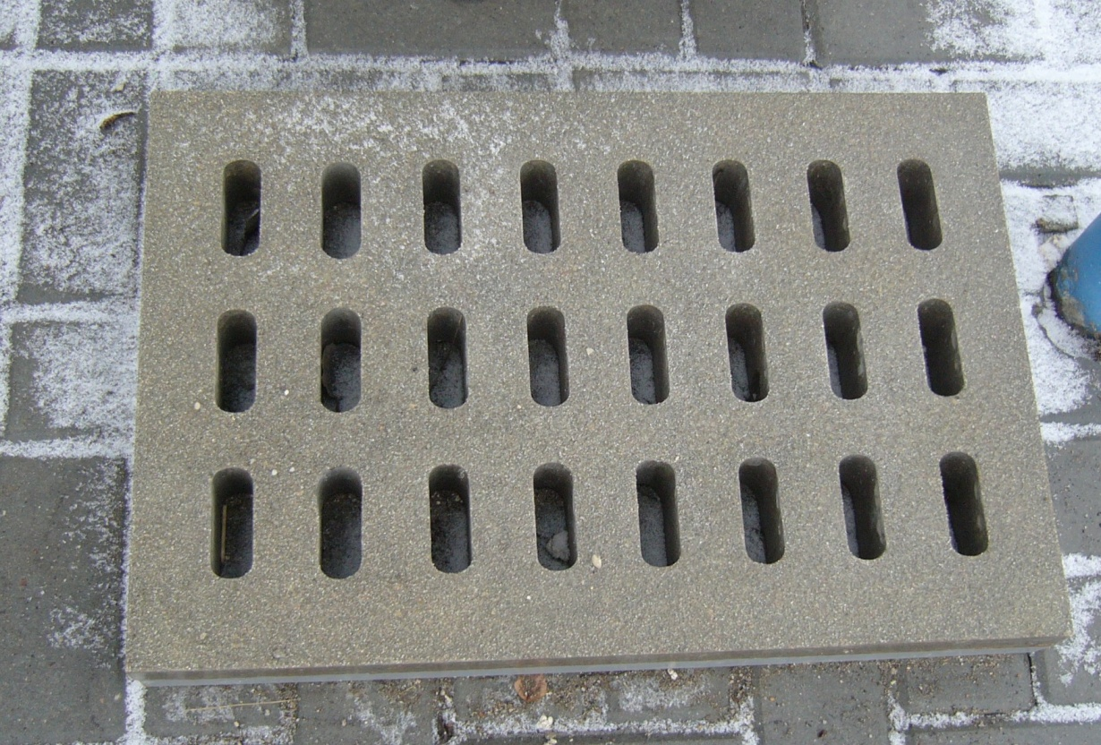
Polymer Concrete Gratings
Polymer concrete gratings are used on the road in the class C 250kN area. In those days, where lots of castings are stolen, this is a perfect alternative.
Several dimension exit.

Slide 14
Access Covers

Slide 15
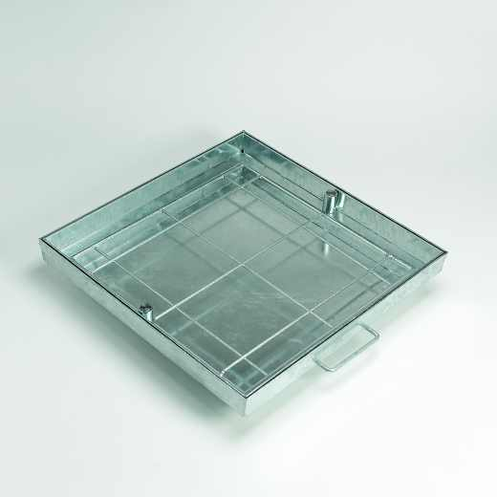
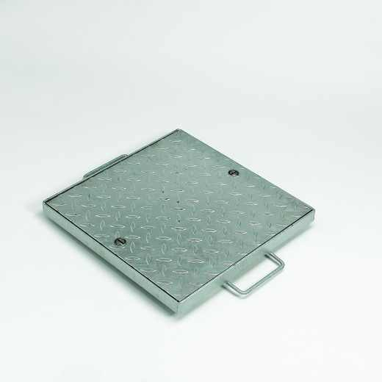
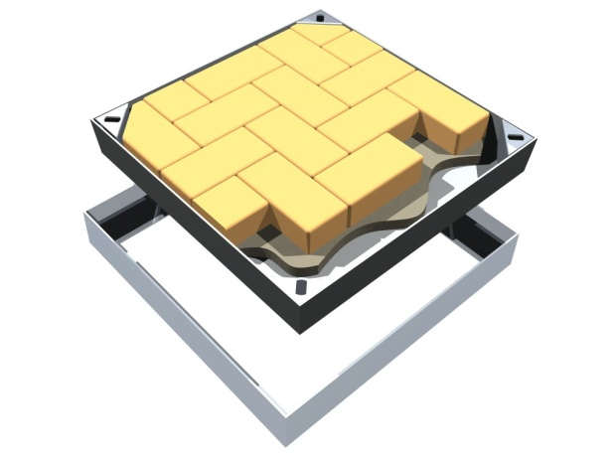
Steel Access Covers
Access Covers are used in many applications.
They are made of Galvanised Steel, Stainless Steel or Aluminium.
The sizes vary from 300 x 300 up to 1200 x 1200 and can also be multi-parts.
Loading classes vary from A 15kN up to D 400kN.

Slide 16
Pull Boxes

Slide 17
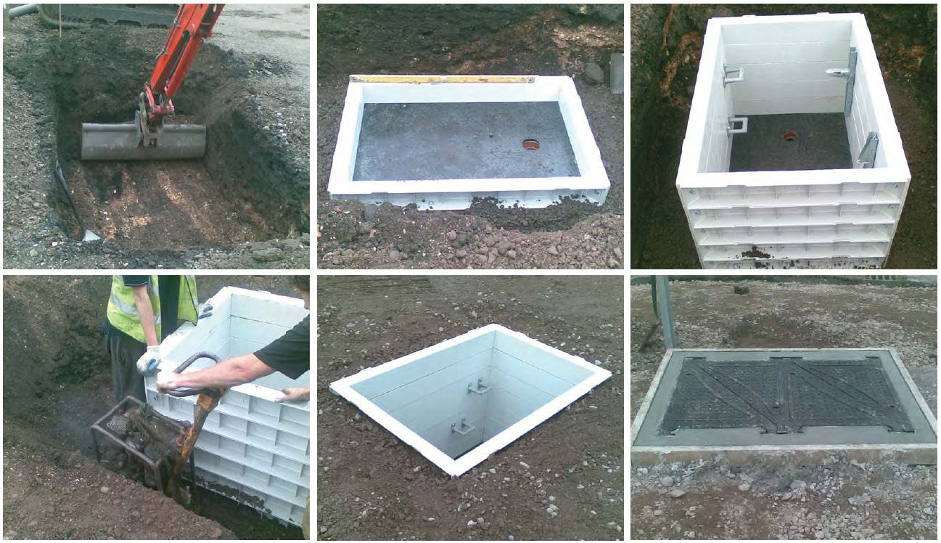
PULL BOXES
RapidSTACKTM Chambers are a superior alternative to traditional class B engineering brickwork, block work or re-enforced cast insitu concrete.
RapidSTACKTM is extremely quick to install, there is no need for a concrete surround and is available in a wide range of sizes. The system is cost effective, resulting in significantly lower labour, plant and road closure costs.
RapidSTACKTM is lightweight and conforms to HSE regulations for `one man lift` manual handling regulations. The chambers are independently tested to EN124 / B125 to D400 loading, and certified by recognised UKAS accredited test facilities.

Slide 18
Other Products

Slide 19
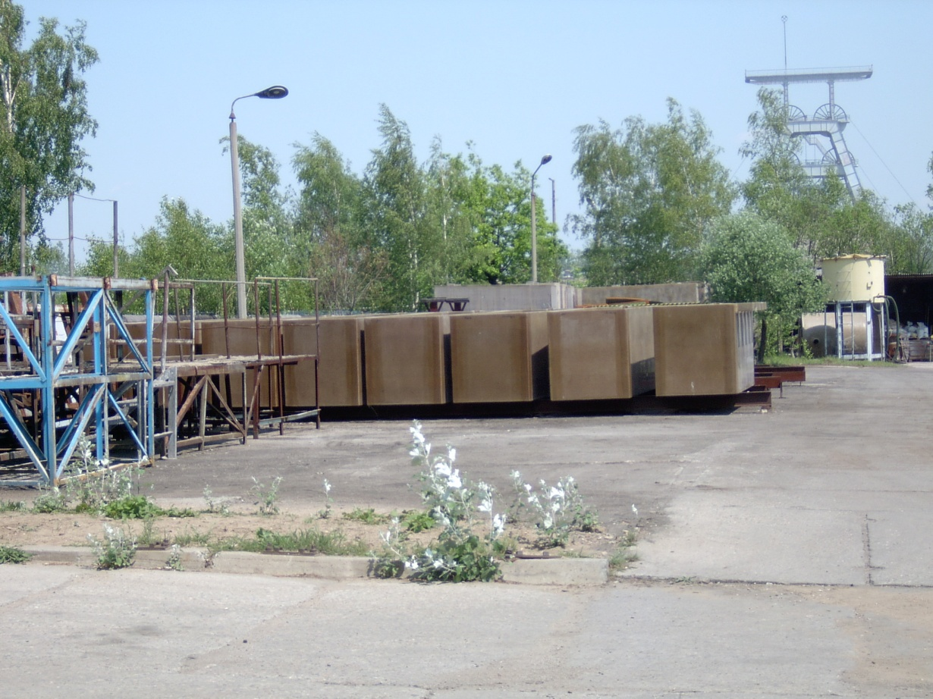
Cells
Since the origin of the production unit back in Chile, we have been producing Cells for the Copper Industry.
Chile being the worldwide leader in Copper production, they developed an alternative way of producing Cells used for the electrolytic bath. The very specific properties of Vinyl Ester make this product a very interesting alternative to steel version.

Slide 20
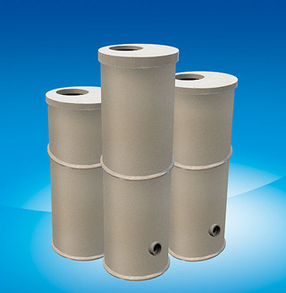
Wells
USE:
Intermediate wastewater pumping station enclosures
Separator enclosures
Sewer wells
Water meter wells
Sand traps

Slide 21
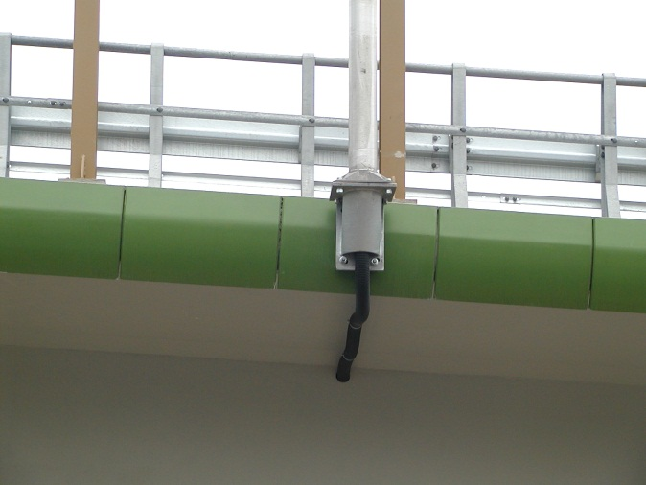
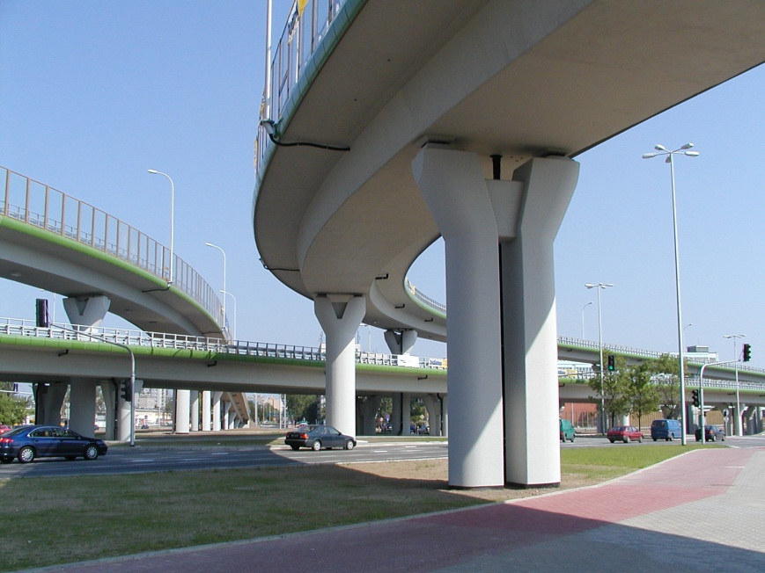
Cornice
Cornices are made of polymer concrete. The advantage of polymer concrete is its flexibility.
The product is covered by a gel coat layer which gives a very smooth feeling. Because of this water will not stick as on normal concrete cornices.
Those cornices can be manufactured in any RAL colour.
Cornices are either standard products but can also be tailor-made.

Slide 22
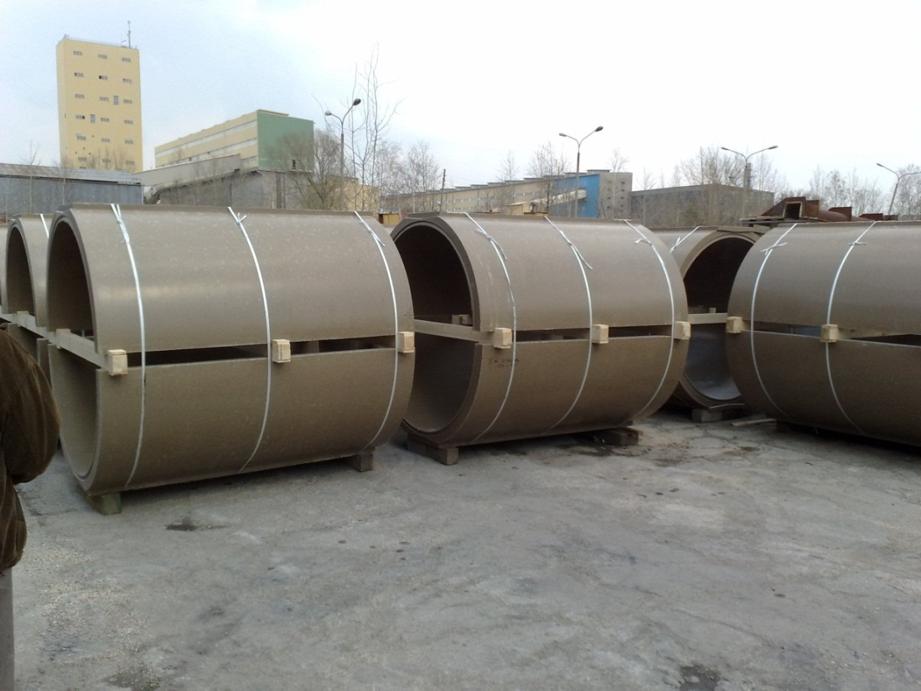
Half Pipe
Large sewage channels up to NW1500,
Channels made of Standard Polymer Concrete or of Vinyl Ester Polymer Concrete.

Slide 23
Contact Details

Slide 24

Contact Details
Reivilo Ltd.
Route d’Ottignies 35
1380 Lasne
Belgium
Phone: +32 475 61 81 25
Fax: +32 2 403 21 22
Email: info@reivilo-ltd.com
www.reivilo-ltd.com

